Slide 1
European Union –
Resource Efficiency Initiative Phase II (2021 – 2023)
Reva Prakash
Deputy Team Leader, EU-REI
January 21, 2023

Slide 2
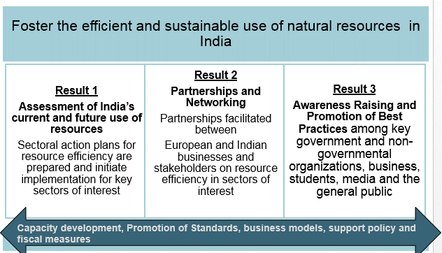

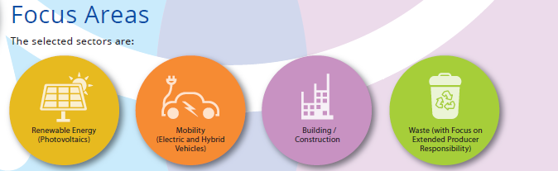
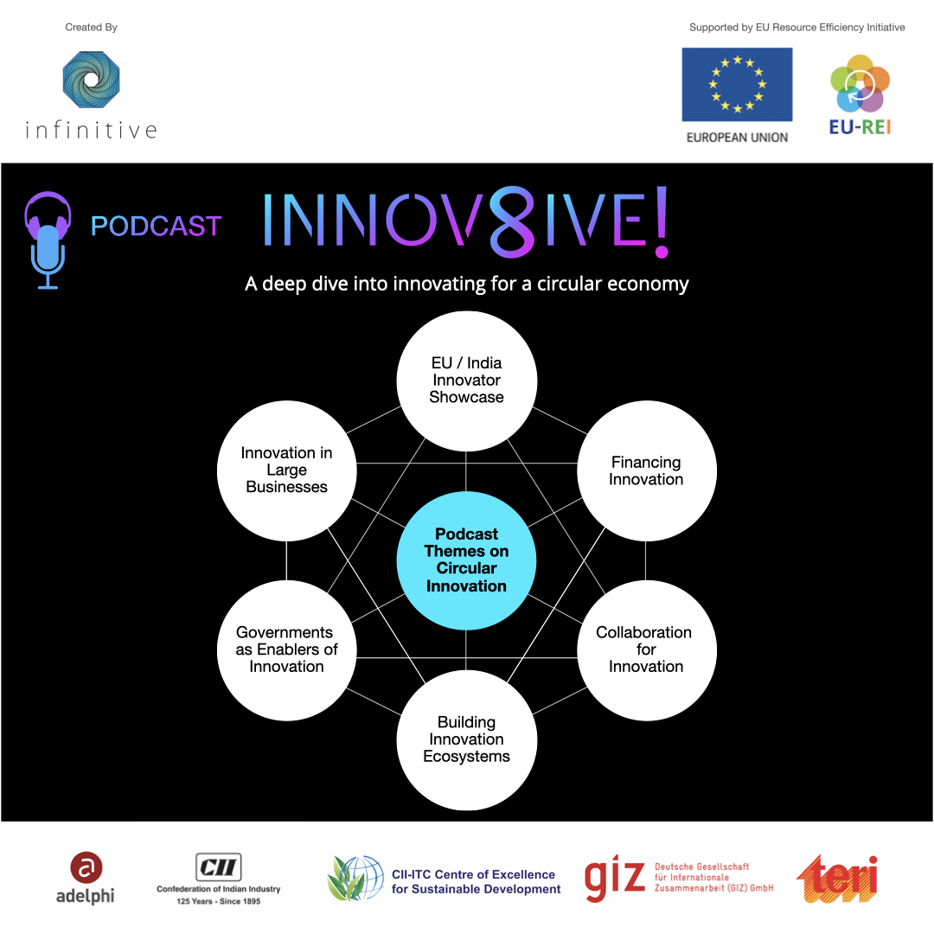
EU Resource Efficiency Initiative (EU-REI)
1 National RE Strategy (Niti Aayog, GoI) Focusing on
Institutional Development with 9 Ministries/Departments
Action Plan till 2020
4 Sectoral RE Strategies
Ministry of Mines
Ministry of Steel
Ministry of Housing and Urban Affairs
Ministry of Electronics & Information Technology
Implementing Partners: the Ministry of Environment, Forest and Climate Change; NITI Aayog
1 draft National Policy on Resource Efficiency (RE)
(MoEFCC, July 2019)
3000 people outreached through events
4 awareness campaigns launched
11 EU Member States Embassies supported for collection of e-waste
3 Business Partnerships on EU-India Business cooperation
2 State RE Strategies
1 State Strategy in Goa launched by Chief minister Goa and EU Ambassador
1 State Strategy in Telangana under formulation
Notes:
Example for a Project or Programm slide with most important aspects/goals and impacts/testimonials (we know Sakri is KfW, just a nice example)

Slide 3
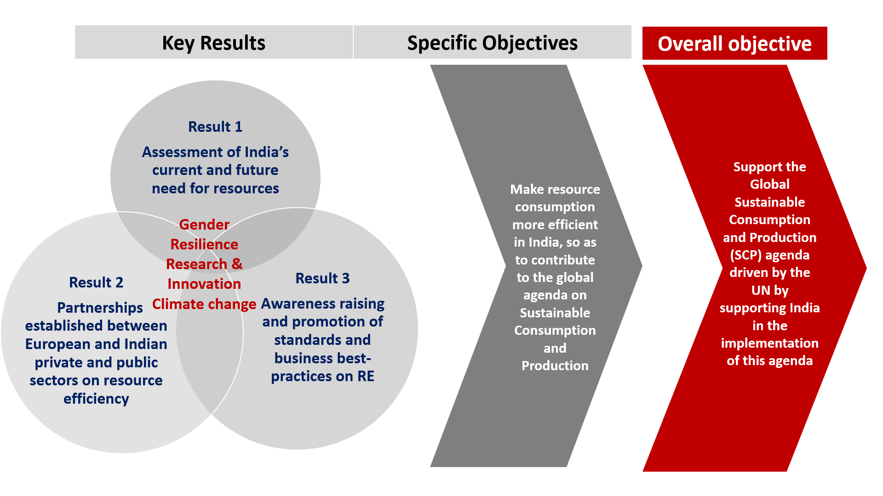
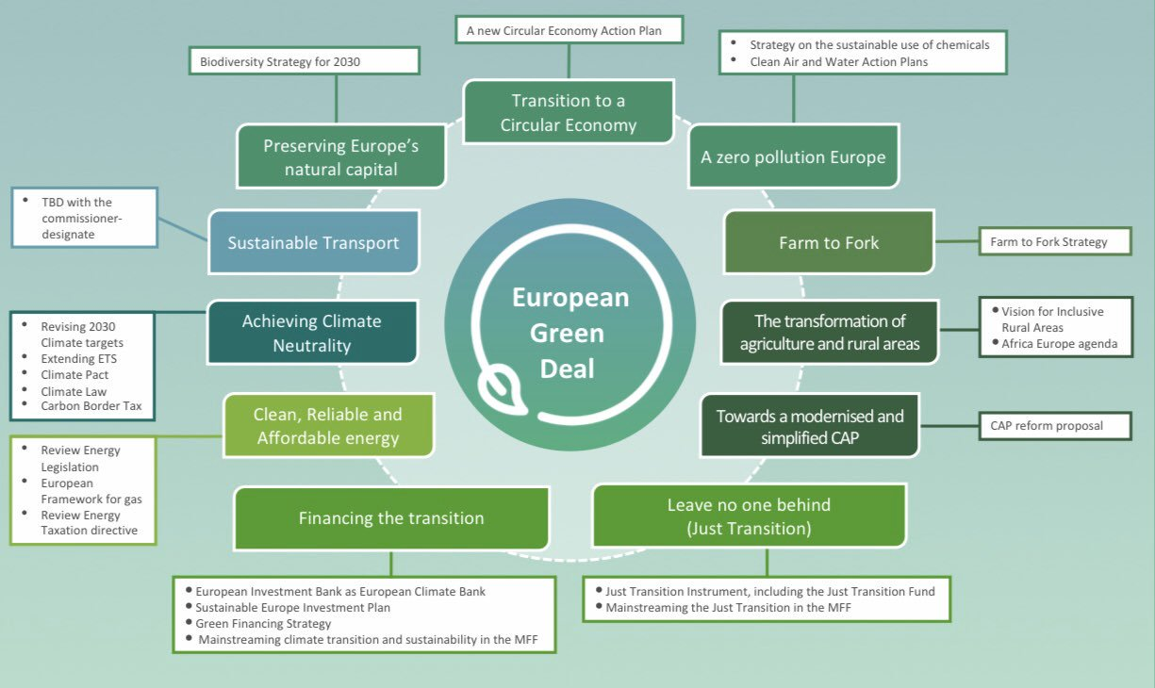
EU Resource Efficiency Initiative (REI) - II
RE-Phase II commissioned by the EU to an international consortium - GIZ, TERI, CII and adelphi
Mode of cooperation: EU-Partnership Instrument (PI)
Project duration: 3 years (01/2021 – 12/2023)
Implementing partner/s
- Key: Ministry of Environment, Forest and Climate Change - Other: NITI Aayog & its CE committees, MeitY, MoM, MoS, selected states

Slide 4


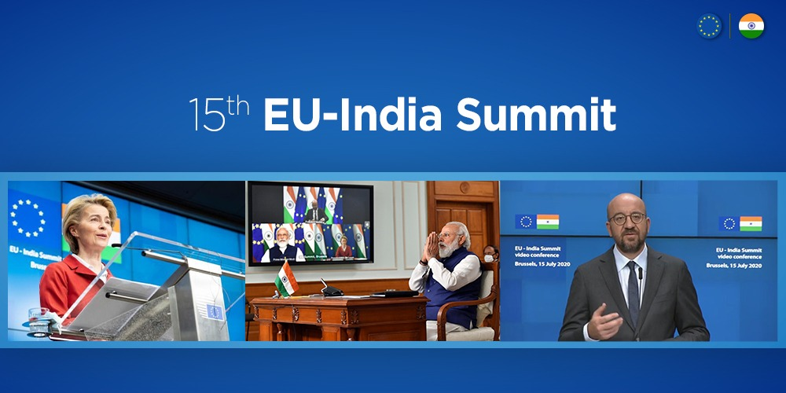
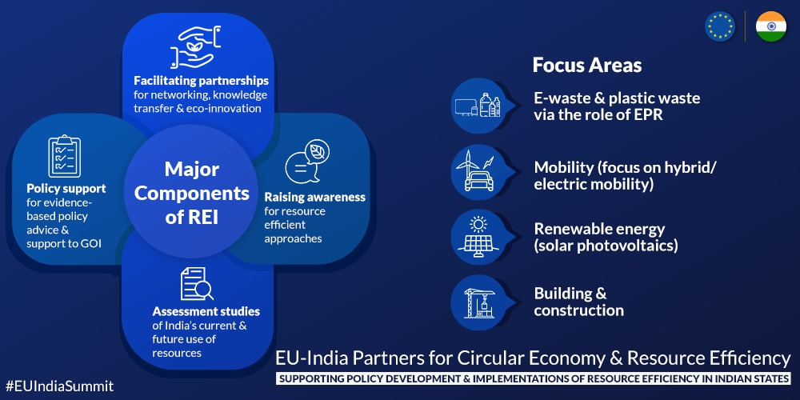





EU-India Partnership for Circular Economy
& Resource Efficiency
Supporting Policy Development & Implementation of Resource Efficiency
Bilateral Policy Dialogue
Open to extra EU and Indian Partners
Knowledge Exchange
EU-India Joint Declaration
on
Resource Efficiency and Circular Economy,
July 2020
Research & Innovation
Financing Instruments
From Policy to
Practice
RE/CE
Skills
Frameworks

Slide 5
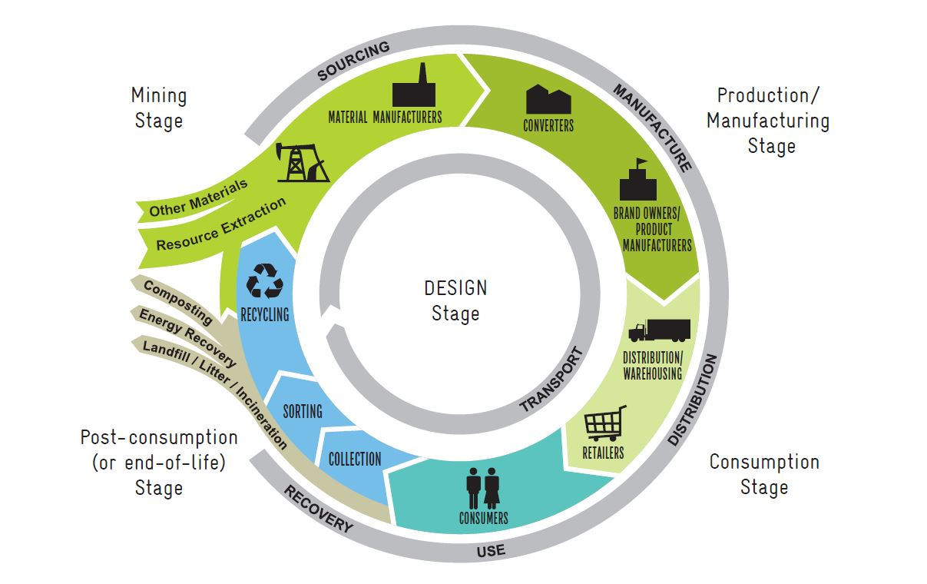
Life cycle Approach to RE and Circular Economy
Minimize the resource use and environmental impacts at each life cycle stage by adopting the concepts of resource efficiency and circular economy using one or more of the 6Rs principles

Slide 6
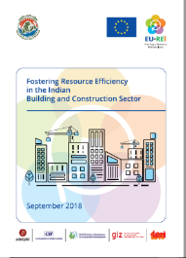
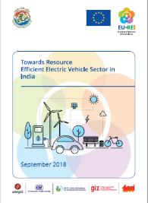
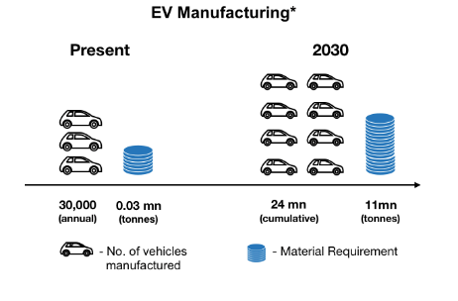
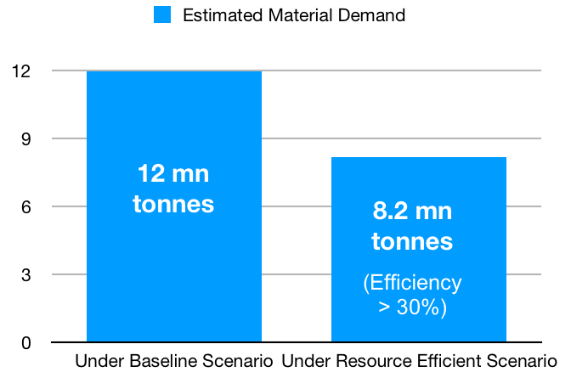
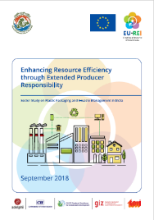
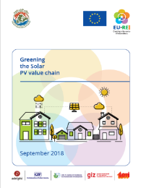
Sectoral Assessment Studies
At its core, four recently developed studies recommend potential areas for policy innovation to foster resource efficiency in the four target sectors

Slide 7
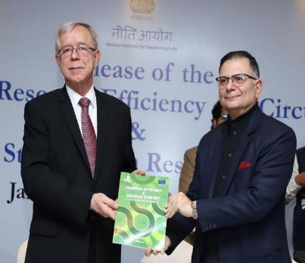
EU-REI: EU and India Partnership: RE Strategy with NITI Aayog
NITI Aayog and EUD release the Resource Efficiency Strategy in Nov 2017
Status Paper and four RE Sectoral Strategies released in Jan 2019
Due support for implementation from REI
Interdepartmental Committee of 9 key ministries
RE Task Force of Experts
Capacity Development RE and Circular Economy in 3 states held at Odisha, Telangana and Goa
RE & CE Strategy initiated for development in Telangana and Goa
Goa RE Strategy released in February, 2020
Mr Tomasz Kozlowski and Mr Mr Ratan P. Watal, releasing the Status Paper on Resource Efficiency and Circular Economy in Jan 2019

Slide 8
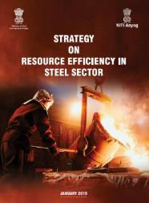
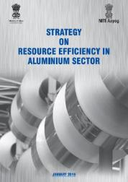
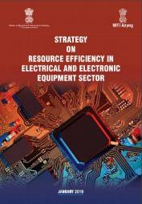
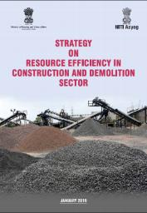
Mainstreaming RE & CE in Policy and Sectoral Areas
NITI Aayog and Mo/Steel, Mo/ Mines, MoHUA, MEITY release
Strategy on RE in Steel Sector
Strategy on RE in Aluminium Sector
Strategy on RE in EEE Sector
Strategy on RE in C&D Sector

Slide 9
Continued Mainstreaming of RE&CE & Leveraging Partnerships
Action Plan & Pilot Implementation
Knowledge Exchange
Support to 3-4 NITI Aayog CE committees
Best Practices and Expertise from EU Member States
Continued Support to MoEFCC’s RE Cell
Capacity Building

Slide 10
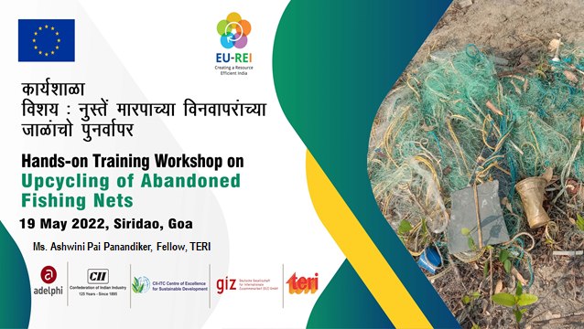
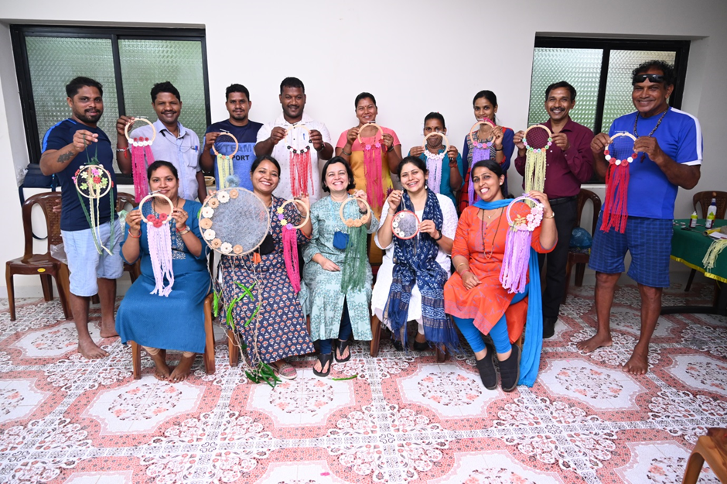

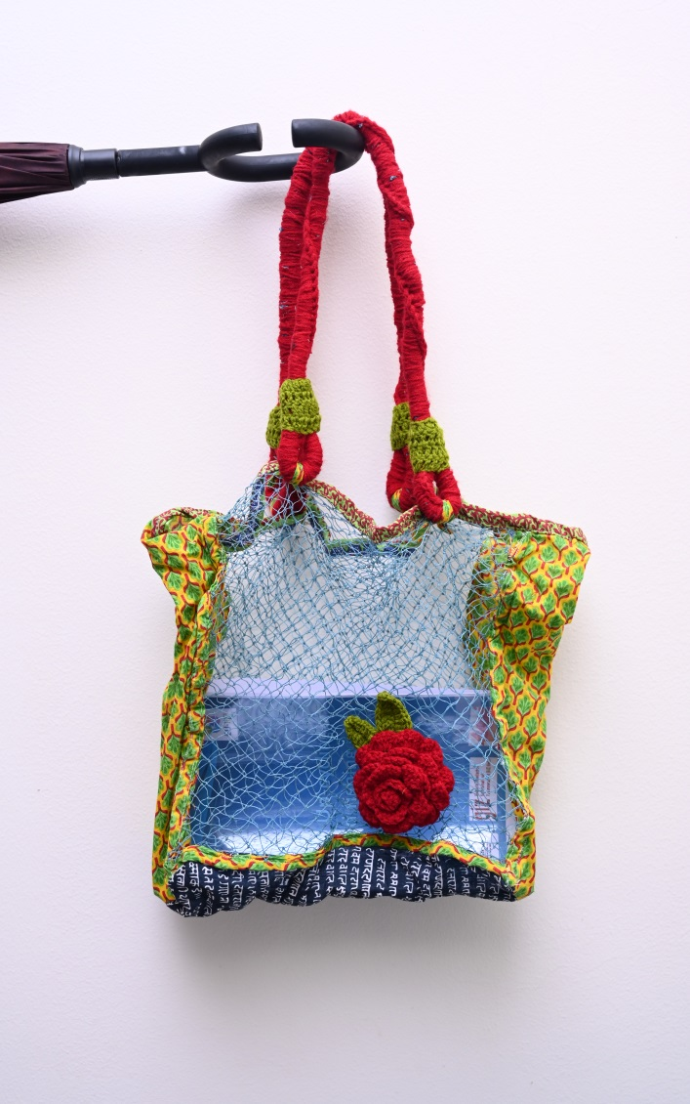
Pilot Measure: Upcycling Discarded Fishing Nets in Goa
Upcycling of Discarded Fishing nets to support the implementation of RE Goa Strategy
Engagement with local fisher-folk community in three fishing villages
Reconnaissance study findings – annually ~21,468 kg of discarded fishing nets generation; Hand-made artefacts using discarded fishing nets were designed and training was given to fisher-folk on upcycling of abandoned fishing nets
Approximately, 550-600 kg of fishing nets is used by the fishermen in the three villages namely, Siridao, Cacara, and Odxel
Scaling up for setting up of a collection mechanism for discarded fishing nets
In consultation with Goa State Pollution Control Board and Goa Fisheries Department
Target - 2 fish landing sites and 3 fishing villages. To potentially benefit ~12,215 fishermen and allied workers.
Ongoing discussions with a German and French start-up for pilot collection through digital Deposit Refund Scheme

Slide 11
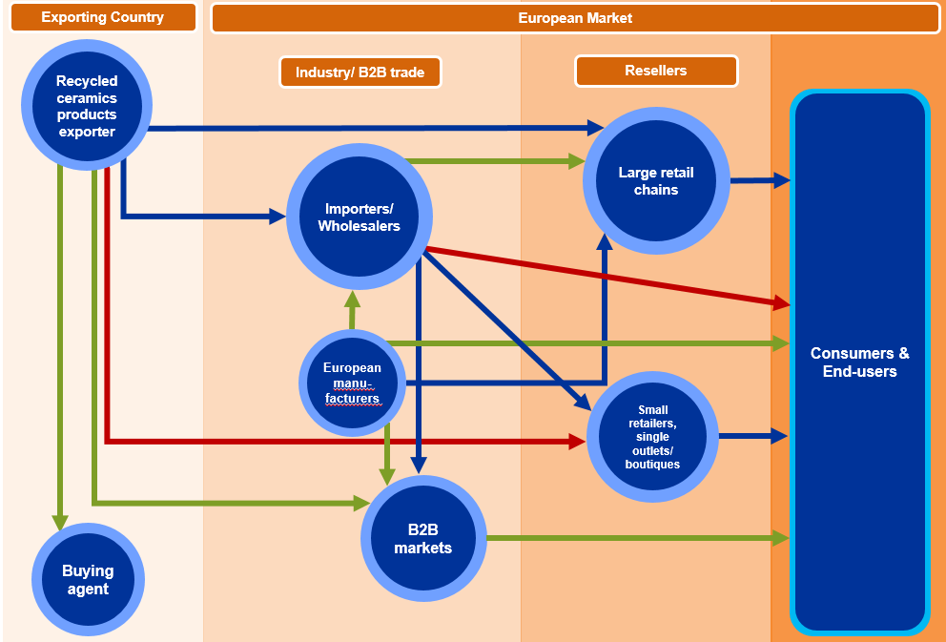
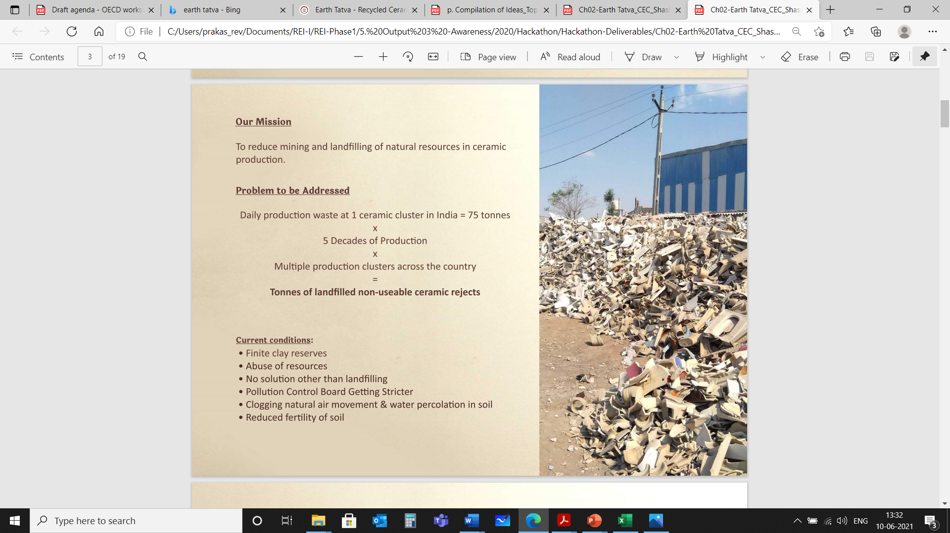
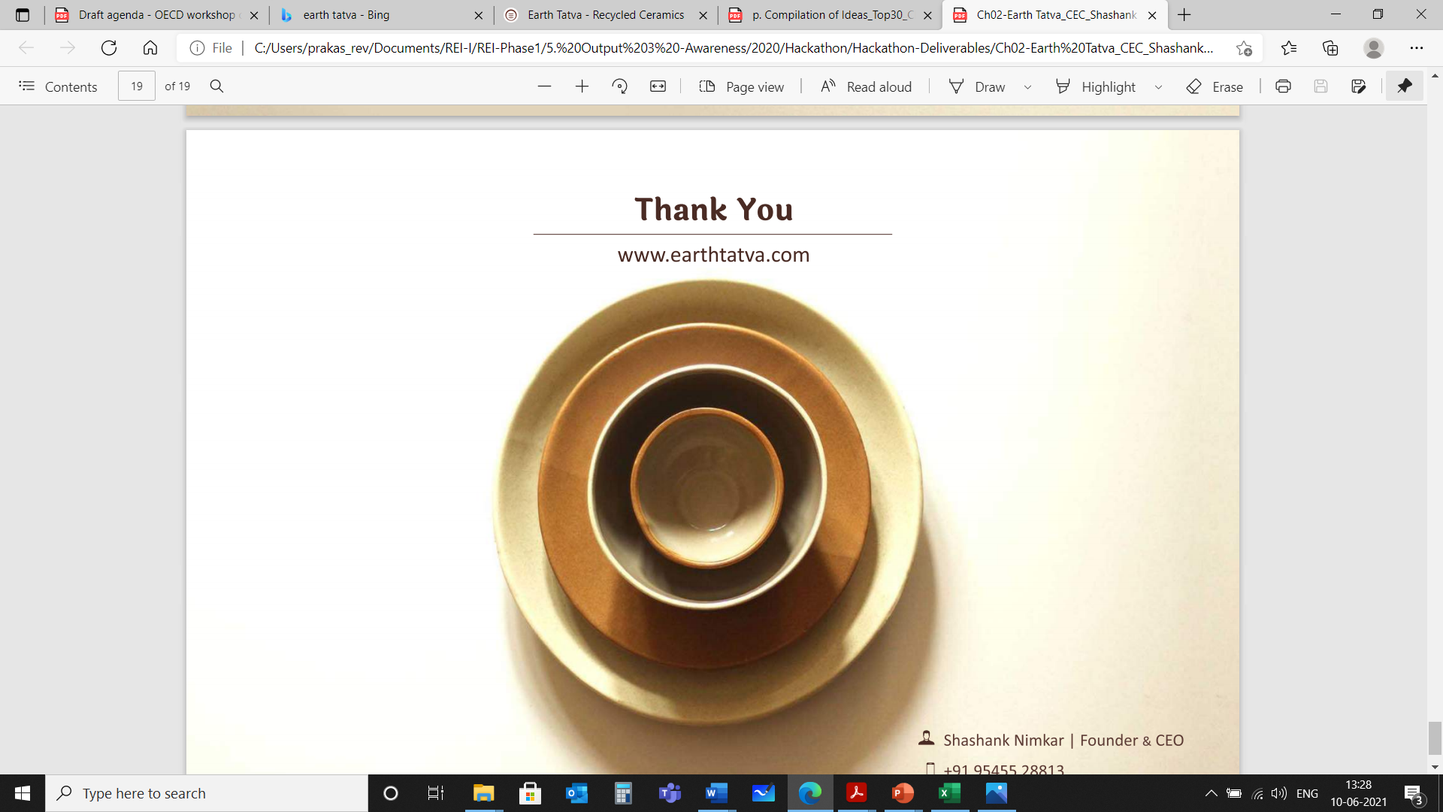
Pilot Measure - Circular Ceramics
Background
Earth Tatva uses 60% of post-industrial landfilled ceramic rejects to make food safe and 35% stronger ceramic wares that are 100% recyclable
Offers green mealing and green building solutions
exemplary case of an entrepreneur within the area of circular ceramics and building materials
Objective
Supporting CE Start-up to Scale-up Impact :
Route-to-market for opportunities of recycled ceramics in EU markets
Assessment of lifecycle benefits of recycled ceramics
Raising awareness about the value-added of circularity among consumers and entrepreneurs
Trade channels for recycled ceramics products

Slide 12
Pilot Measure: Supporting Development of Waste Recycling Park
Objective
~44 hectares in Tholai Industrial Area, Jaipur
Being undertaken by Rajasthan State Pollution Control Board and Rajasthan Industrial Development and Investment Corporation
Selected waste streams: plastic waste, e-waste, hazardous waste, waste from PV panels and storage batteries, metal scrap, and EOL vehicles
EU-REI Support:
Prefeasibility Study for the Waste Recycling Park
Study on Benchmarking of Best Practices for Eco-Industrial Park
Zoning and Master Planning for the Waste Recycling Park to be undertaken
Pre-feasibility Study – Key considerations and proposals
The study provided evaluation criteria for recyclers of different waste streams within the proposed WRP/RRP, including overall rating criteria for technologies to be adopted by the recyclers
Environmental considerations included, water, wastes (including solid and liquid wastes), land, air, and socio economic and health environment and green buildings for convention centres, guest houses, etc.
The social criterion included amenities imperative for the local people and potential employees (e.g. transportation, public conveniences, complementary nature of business operations, training facilities)
Economic considerations include efficient connectivity and transport linkages for material procurement across for waste processing, common infrastructure including system for supply of water, heat, power, gas, communication cables, etc.,

Slide 13
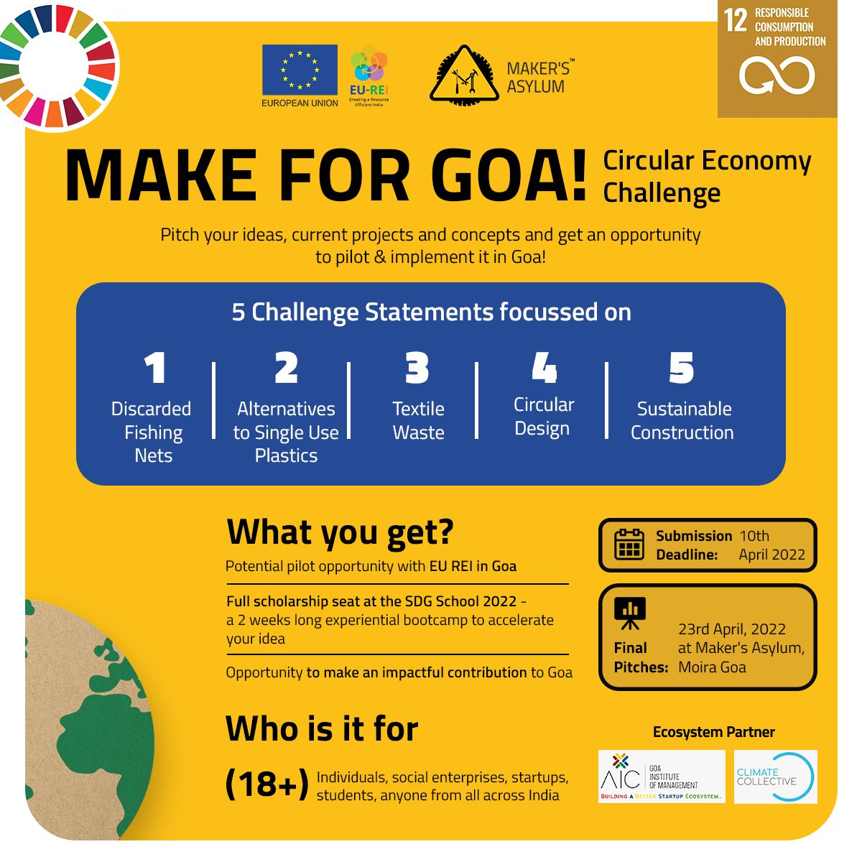
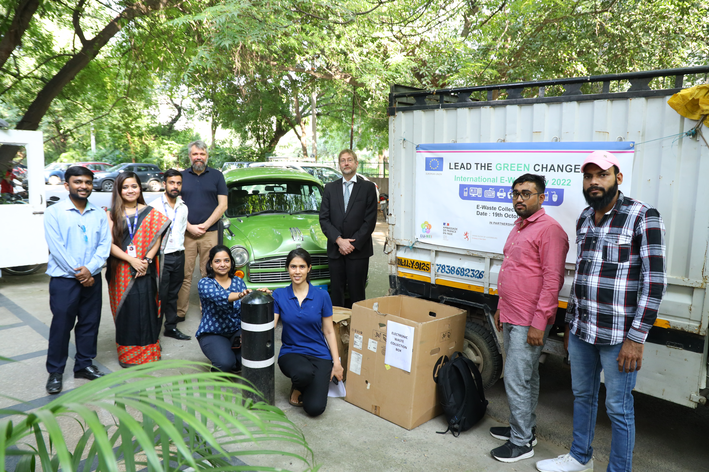
Overview Result 3: Key Activities
Outreach & Capacity Development
3 Repair Cafes for Oxygen Concentrators (focus on Decentralised Manufacturing and Building Resilience) (September – December 2021)
SDG-12 Challenge – Make For Goa (focus on discarded fishing nets, alternatives to single use plastics, textile waste, circular design, sustainable construction) (April 2022)
RE&CE Training Toolkit prepared for ACMA and ToT sessions undertaken (May 2022)
Result 3
Awareness Raising on RE and CE
Setting up of a RE&CE Innovation Lab
Educational course/ awareness campaigns
RE&CE course for architects with Council of Architecture
RE&CE Training Programme for Youth, and Women Entrepreneurs (IYCN)
E-waste Collection Drive in 2022

Slide 14
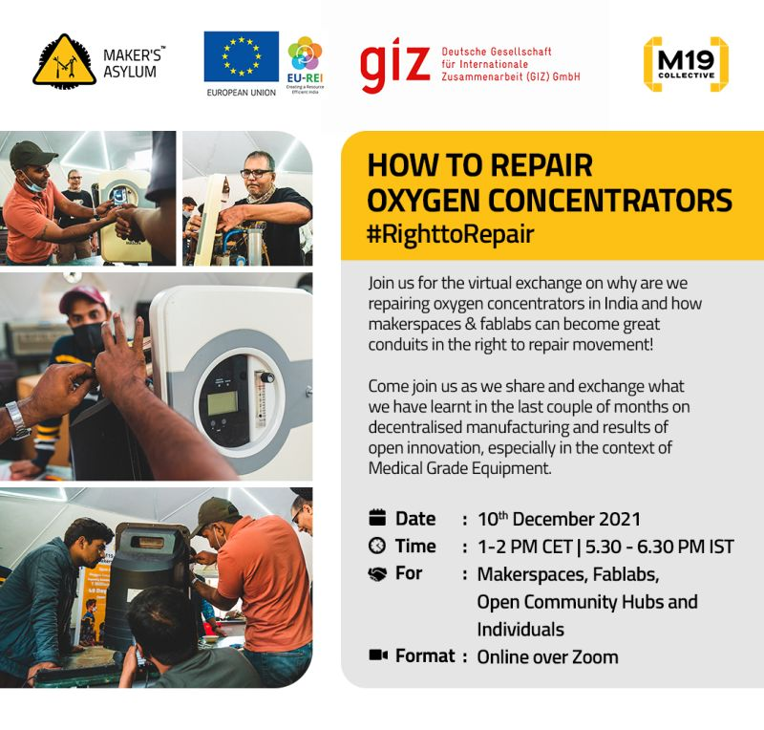
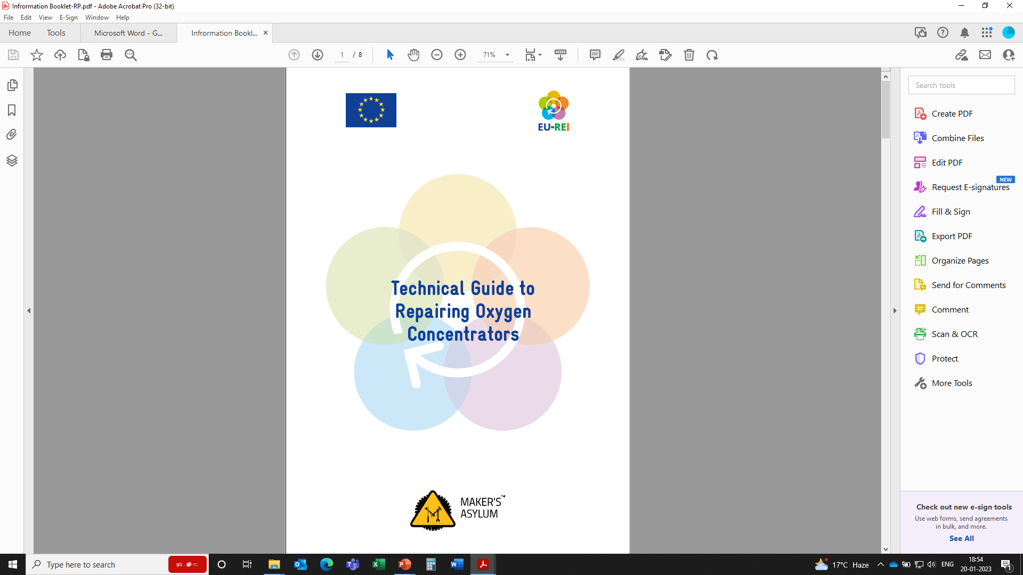
Resilience and Circular Economy
Extension of Product life through repair of oxygen concentrators in Goa (with Makers Asylum)

Slide 15

THANK YOU
www.eu-rei.com

